Slide 1


HARSHA INSTITUTE OF MANAGEMENT STUDIES
PRESENTATION ON
Smart Farming: Crop Recommendation
And Yield Prediction
Reg no: P03EC22S126033
Under the Guidance of
Dr.Balakrishna N
Associate Proffessor
Department of Computer Application

Slide 2
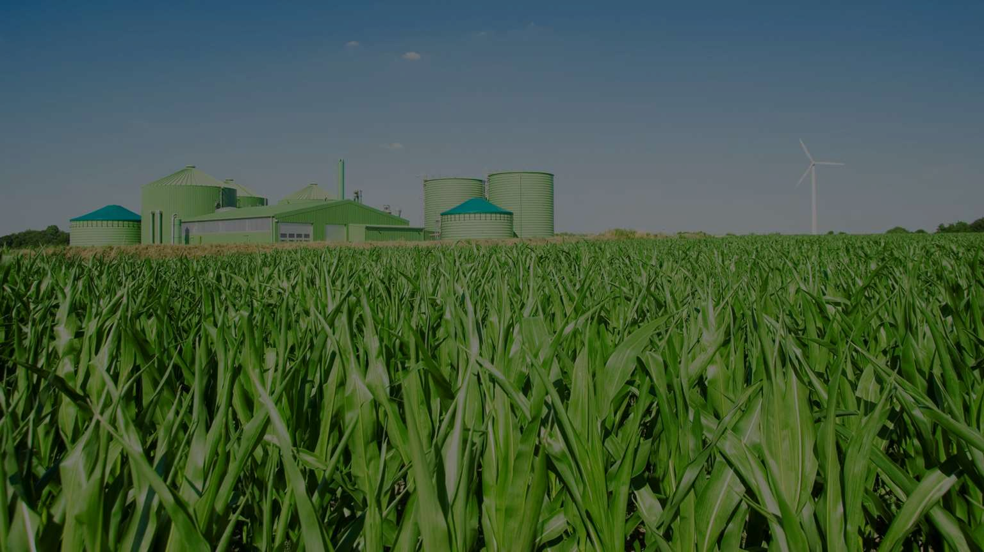
SMART FARMING

Slide 3

CONTENTS
Introduction
Existing System
Proposed System
Module Description
Model Selection And Description
Feature Engineering
System Architecture
Hardware And Software Requirements
Screenshots
Conclusion
Future Enhancement

Slide 4
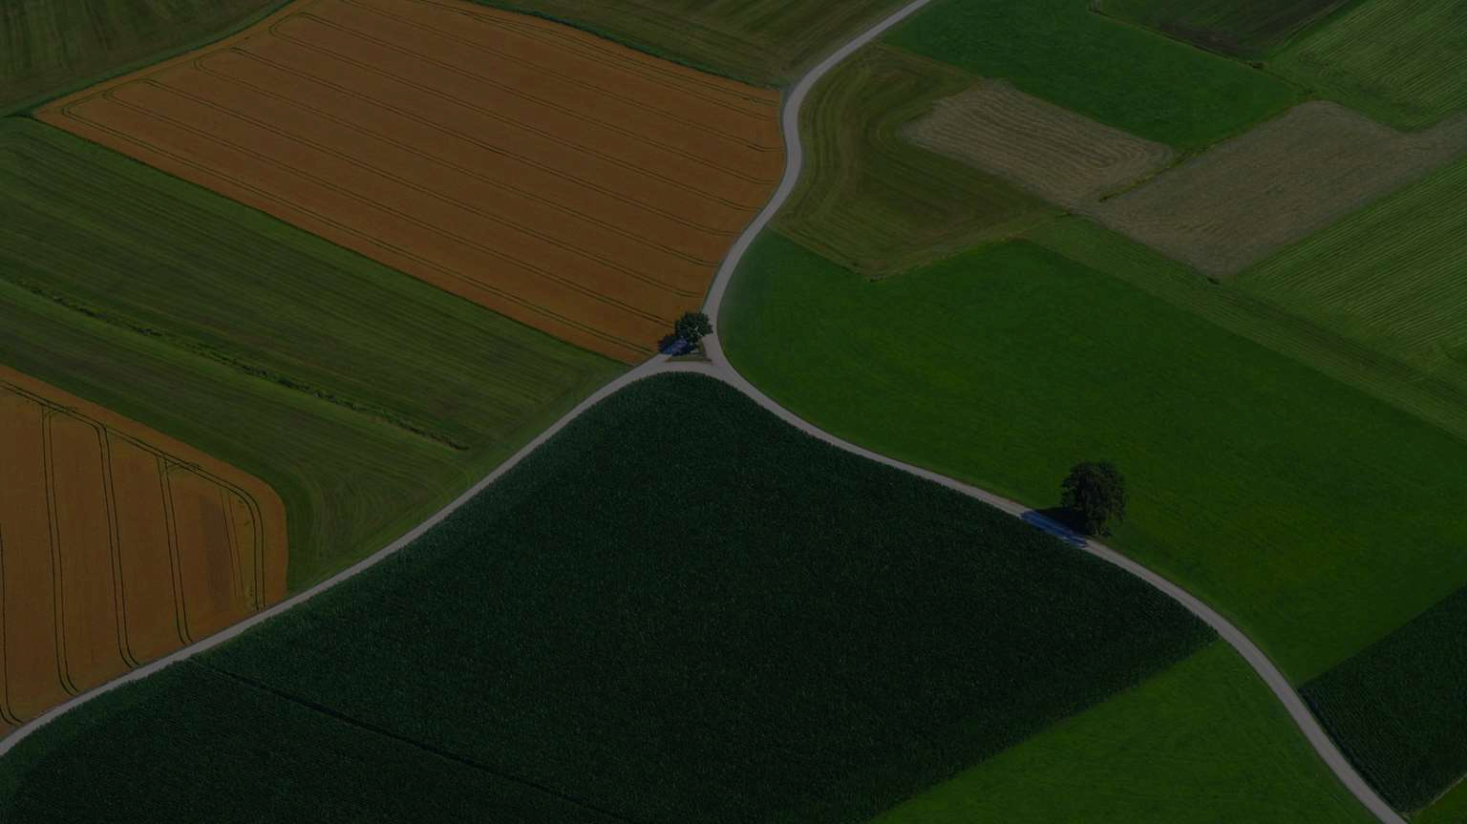
IN TRODUCTION
The ever - growing global population demands efficient and sustainable agricultural practices. Smart farming, leveraging machine learning, offers a promising solution. This project investigates crop recommendation and yield prediction to optimize crop selection and maximize yield. We will compare three machine learning algorithms: K - Nearest Neighbours (KNN), Support Vector Machine (SVM), and Logistic Regression. These algorithms will be trained on data containing soil characteristics, climatic conditions, and historical yield information. The project will evaluate the models' performance in recommending suitable crops for specific land conditions. We will use metrics like accuracy, precision, recall, F1 -s core, and confusion matrix to identify the most effective approach for maximizing crop .

Slide 5
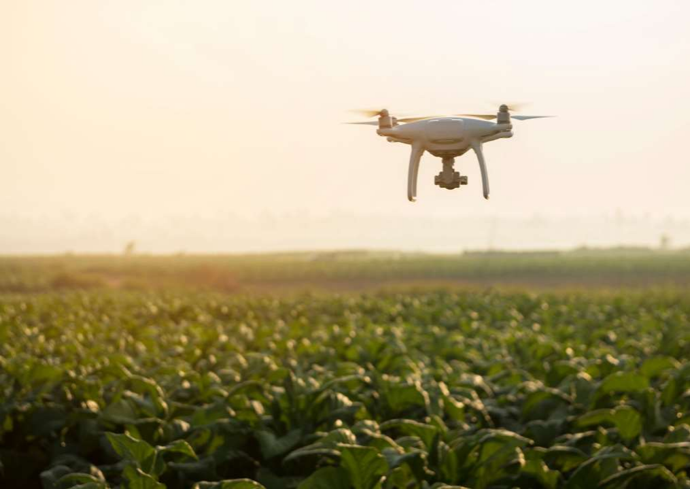



EXISTING SYSTEM
Manual analysis of
agricultural data
Simple statistical
models
Rule-based systems

Slide 6
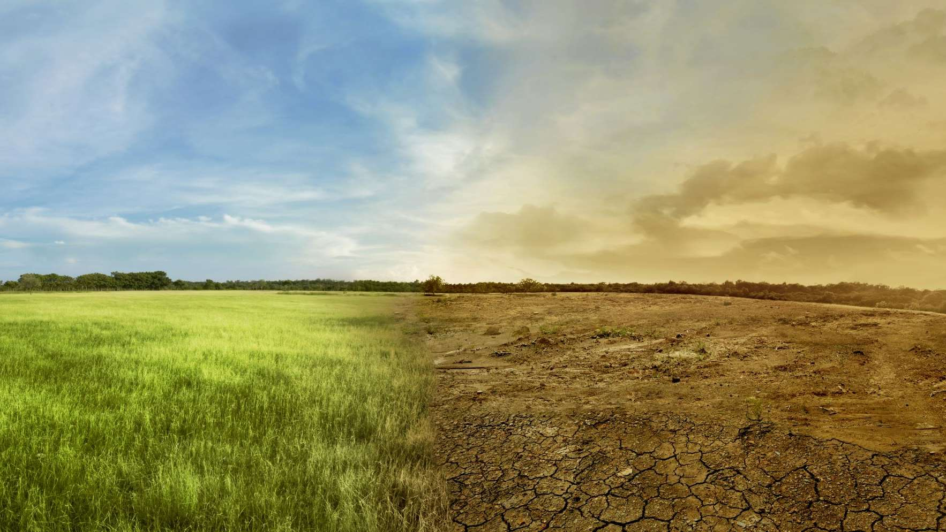





PROPOSED SYSTEM
Data Acquisition
Data
Preprocessing
Machine
Learning Model
Training
Model
Evaluation
Crop
Recommendation
and Yield
Prediction

Slide 7
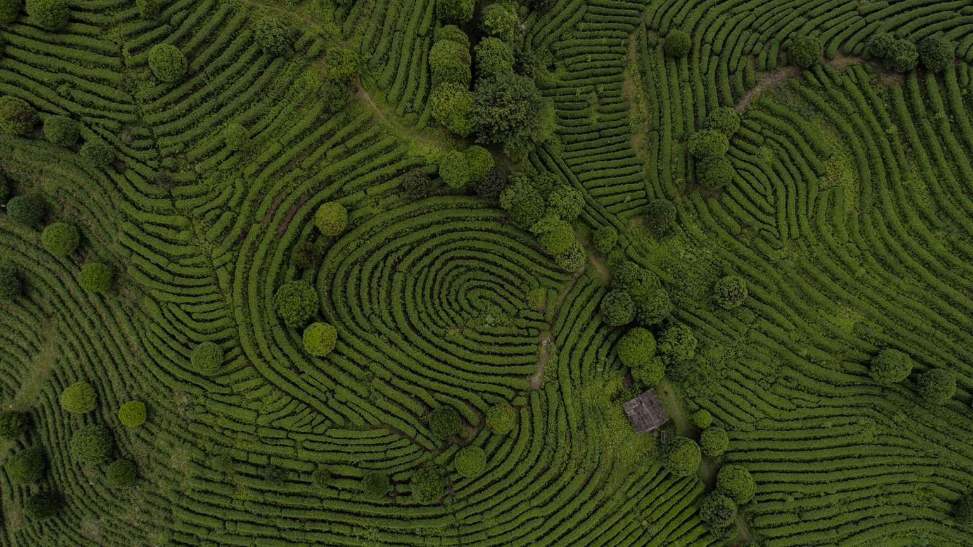


MODULES DESCRIPTION
Data Collection
Data Preprocessing

Slide 8
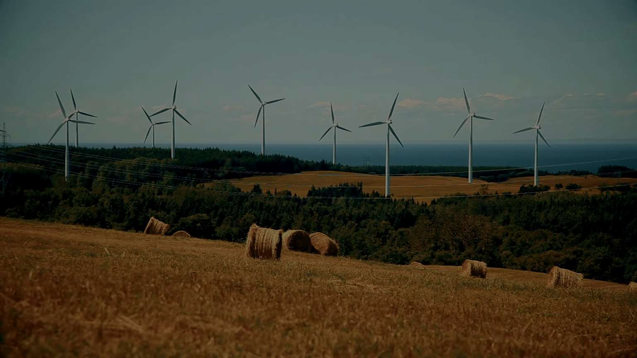
DATA COLLECTION
Collect data relevant to crop selection and yield prediction. this may include:
Soil properties (pH, organic matter, nutrients)
Climate data (rainfall, temperature, humidity, sunlight)
Historical yield information for various crops on similar land
Explore additional data sources like satellite imagery or sensor readings(OPTIONAL) to enrich the data.

Slide 9
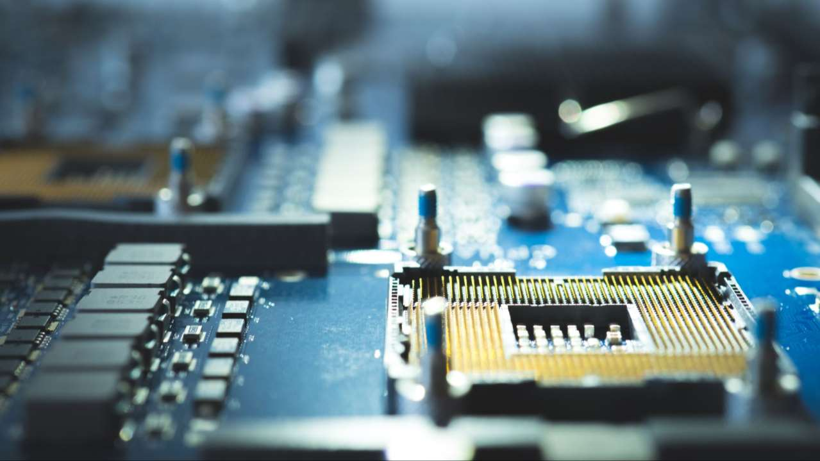
DATA PREPROCESSING
Clean the collected data by handling missing values, outliers, and inconsistencies.
Format the data into a structure suitable for machine learning algorithms.
This may involve data normalization or encoding categorical variables.

Slide 10
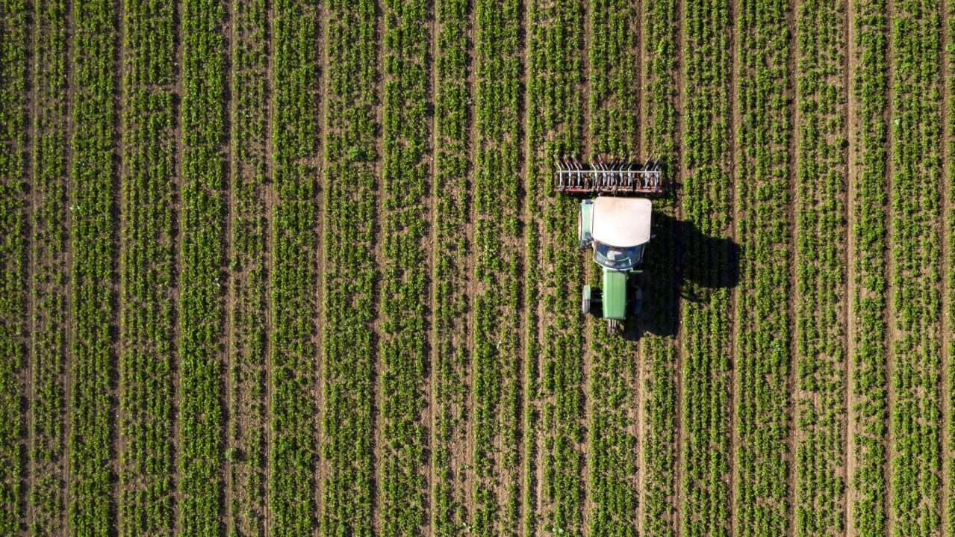


Model Selection and Description
K-Nearest Neighbours
(KNN)
Support Vector Machine
(SVM)
Logistic Regression

Slide 11




FEATURE ENGINEERING
This module focuses on creating and refining
features used by the machine learning models.
Analyze the collected data to identify the most
relevant features for crop recommendation and
yield prediction.
Feature selection techniques can be employed to
identify the most informative features and
potentially reduce model complexity.

Slide 12
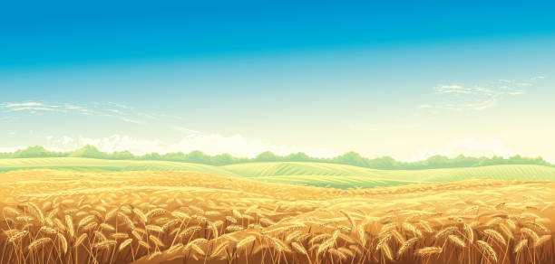






SYSTEM ARCHITECTURE
WEATHER AND CROP FORECASTING INPUT STATISTICAL DATA
DATA PRE-PROCESSING
DIMENSIONAL REDUCTION
SUITABLE CLUSTRING ALGORITHM
VERIFICATION OF DATA
FORECASTING

Slide 13
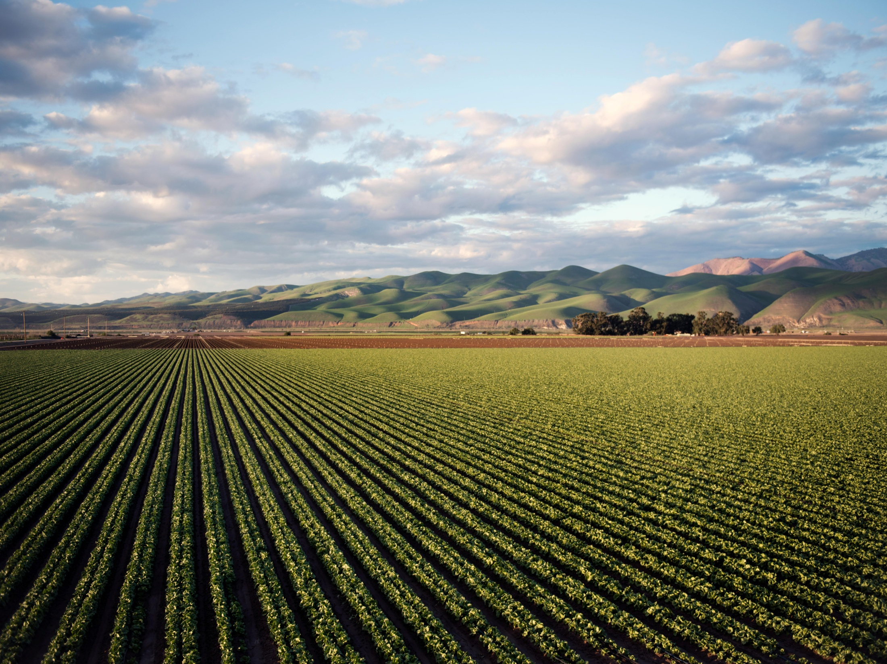
HARDWARE REQUIREMENT
RAM : 8GB or higher
ROM : 500GB or higher
CPU : Intel i5/Ryzen 5 or higher
GPU : Optional
SOFTWARE REQUIREMENT
Python
Machine Learning Libraries
Jupyter Notebooks

Slide 14
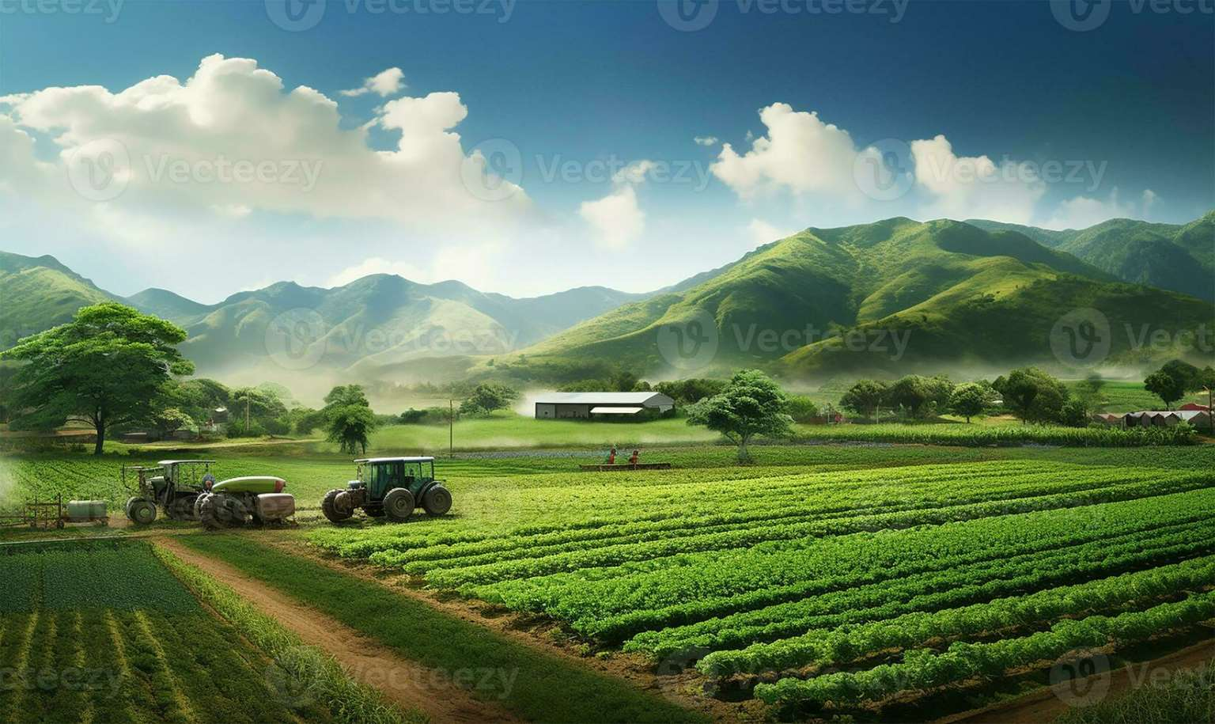
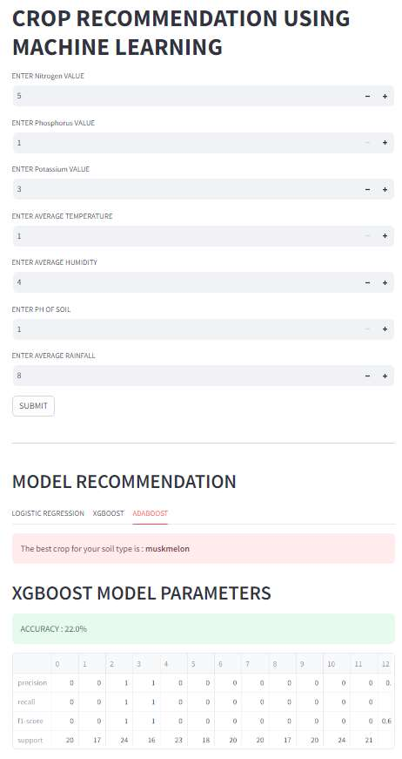
SCREEN SHOT
ADABOOST MODEL

Slide 15
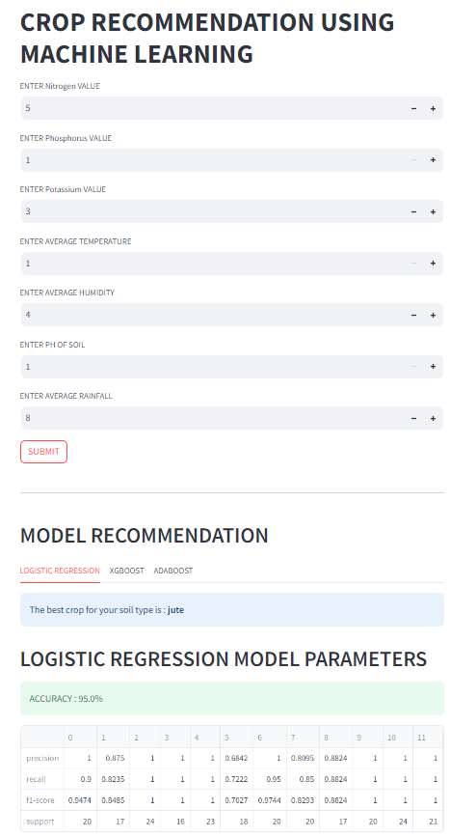
SCREEN SHOT
LOGISTIC REGRESSION MODEL

Slide 16
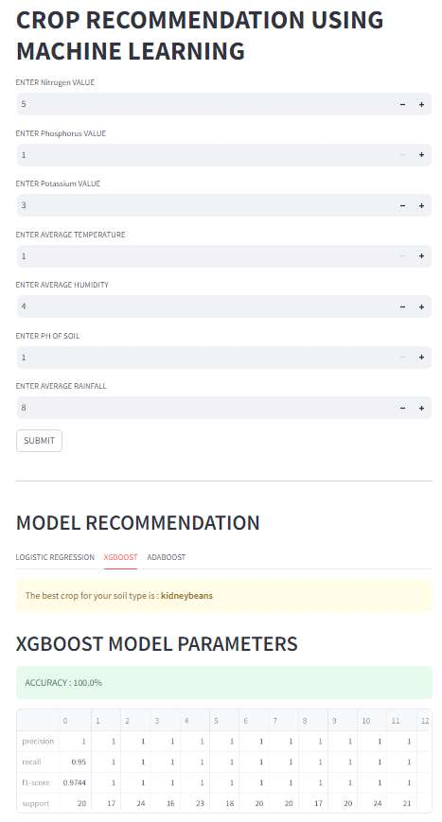
SCREEN SHOT
XGBOOST MODE

Slide 17
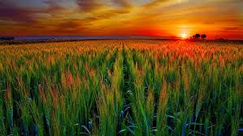
CONCLUSION
CONCLUSION
The farmers can adapt to climate changes to some degree by shifting planting dates, choosing varieties with different growth duration, or changing crop rotations.
This scenario mainly concentrates on weather forecasting, crop yield prediction,
and crop cost forecasting. These factors help the farmers to cultivate the best food crops
and raise the right animals in accordance with environmental components.
The farmers can adapt to climate changes to some degree by shifting planting dates, choosing varieties with different growth duration, or changing crop rotations.
This scenario mainly concentrates on weather forecasting, crop yield prediction, and crop cost forecasting. These factors help the farmers to cultivate the best food crops and raise the right animals in accordance with environmental components.

Slide 18
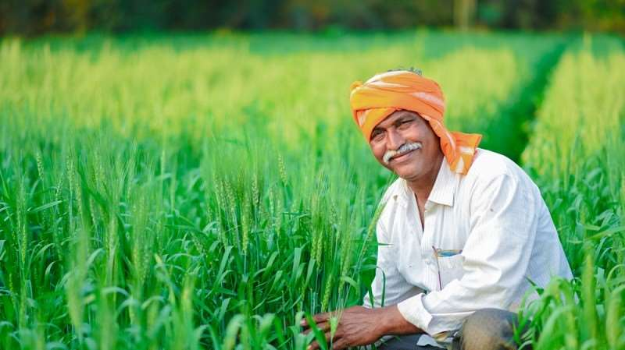
THANK YOU

